Slide 1
Digital Portfolio
STUDENT NAME: Meenakshi R
REGISTER NO: 2428C0094
NMID: 94FC452FAB18C68A00448B881B57EAB3
DEPARTMENT: BSC AIML
COLLEGE: Sri Krishna Adithya College of Arts and Science

Slide 2
Digital Portfolio

Slide 3


AGENDA
Problem Statement
Project Overview
End Users
Tools and Technologies
Portfolio design and Layout
Features and Functionality
Results and Screenshots
Conclusion
Github Link
3/21/2024 Annual Review

Slide 4

PROBLEM STATEMENT
Many creative professionals, students, and job seekersstruggle to showcase their skills, projects, andachievements in a single, easily accessible platform.Traditional resumes and printed portfolios are oftenlimited in interactivity and reach, making it difficult forpotential employers or clients to get a complete pictureof an individual’s capabilities. The goal of this project isto design a digital portfolio website that provides avisually appealing, interactive, and organized way topresent personal information, skills, projects, andcontact details. The portfolio should be responsive,user-friendly, and highlight the creator’s workeffectively, allowing visitors to quickly understand theirexpertise and accomplishments.

Slide 5

PROJECT OVERVIEW
The Digital Portfolio project aims to create an interactiveand visually appealing online platform where individualscan showcase their personal information, skills, projects,and achievements. The portfolio serves as a modernalternative to traditional resumes or printed portfolios,providing a centralized space that is accessible anytimeand anywhere The portfolio is designed to be user-friendly and responsive, ensuring that visitors can easilynavigate through sectionsAbout Me: A brief introduction with profile picture andbackground information.

Slide 6

WHO ARE THE END USERS?
1.Potential Employers or Recruiters – They view your portfolio
to assess your skills, projects, and suitability for a job or
internship.
2.Clients or Customers – For freelancers or service providers,
clients use the portfolio to evaluate past work and decide
whether to hire you
3.Teachers, Mentors, or Evaluators – In an academic context,
instructors or mentors might use it to review your projects or
assignments.
4.Peers or Colleagues – Other professionals or students might
explore your portfolio for collaboration or inspiration.
5.General Public / Visitors – Anyone interested in learning
about your work, achievements, or creative projects.

Slide 7

TOOLS
1.HTML (Hypertext Markup Language) – For
structuring the content of the portfolio.
2. CSS (Cascading Style Sheets) – For styling,
layout, and visual presentation.
3. JavaScript – To add interactivity and
dynamic features (e.g., animations, sliders,
modal pop-ups).
4. Image Editing Tools – Tools like
Photoshop, Canva, or GIMP to prepare and
optimize images for the portfolio.
5. Code Editors – Tools like VS Code, Sublime
Text, or Code Pen for writing and testing
code.
6. Version Control – Tools like Git and GitHub
for managing code versions and sharing the
portfolio
7. Web Hosting / Deployment Platforms –
Platforms like GitHub Pages to make the
portfolio accessible online.

Slide 8
Techniques
1. Plan the purpose (job, study,
freelancing).
2. Choose your best work (quality over
quantity).
3. Organize content into sections
(About Me, Skills, Projects, Contact).
4. Keep design clean and easy to
navigate.
5. Use multimedia (images, videos,
documents).
6. Pick the right platform (website,
Behance, GitHub, Google Drive).
7. Make it mobile-friendly and fast to
load.
8. Add personal branding (photo, bio,
logo).

Slide 9
POTFOLIO DESIGN AND LAYOUT
1. Home Page – Name, photo/logo, and
short intro.
2. About Me – Background, goals, or
bio.
3. Skills – Technical and creative
strengths.
4. Projects/Work – Best samples with
images & links.
5. Resume/Achievements – Education,
experience, award
6. Contact – Email, social media, or
form.
9

Slide 10
FEATURES AND FUNCTIONALITY
1.Show personal details like name, photo, and bio.
2.Highlights key skills and strengths
.
3.Displays best projects and work samples
4.Supports multimedia like images, videos, and documents.
5.Includes resume, education, and achievements.
6.Has simple navigation with menus and sections.
7.Works on all devices (mobile, tablet, computer).
8.Can be shared easily with a link.
9.Allows viewers to contact you directly.
10.Can be updated anytime with new work or skills

Slide 11
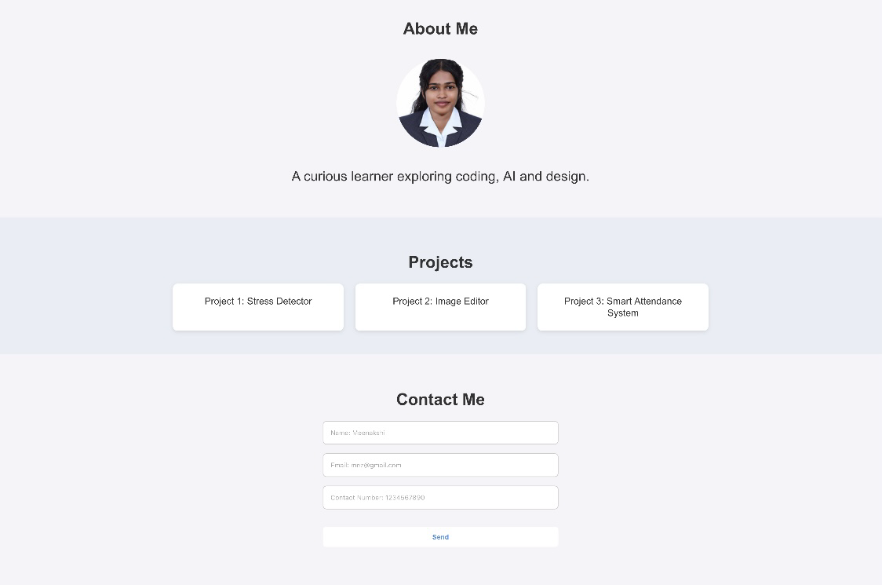

RESULTS AND SCREENSHOTS
3/21/2024 Annual Review
11

Slide 12
CONCLUSION
A digital portfolio is a modern and
effective way to showcase personal
skills, achievements, and work samples.
It helps in building a strong professional
identity, makes sharing easy, and allows
employers or educators to quickly view
your capabilities. Since it can be
updated anytime, a digital portfolio
remains a dynamic tool for career
growth, academic success, and personal
branding.
12

